Slide 1
Social buzz ANALYIS(SQL)
Rohit Waghmare

Slide 2
CONTENTS
Introduction
Project Overview
Dataset Overview
SQL Query Samples
Summary

Slide 3
INTRODUCTION
As part of the Forage Virtual Internship with Accenture North America, this project focuses on analyzing a social media buzz dataset provided by the company. The goal is to extract actionable insights from user reactions, content types, and sentiments across various social media platforms.
Data Cleaning: The raw dataset was cleaned using Power Query to remove inconsistencies and prepare it for analysis.
Data Analysis: SQL was used to query the cleaned data, aggregate key metrics, and derive insights on user behavior, engagement patterns, and reaction scores.
This analysis provides a comprehensive view of social buzz trends, helping identify how different content categories and reactions drive user engagement.

Slide 4
Project overview
SOCIAL BUZZ-SOCIAL MEDIA CONTENT CREATION

Slide 5
This project was completed as part of the Accenture North America Virtual Internship on Forage, focused on analyzing social media buzz data. The primary objective was to uncover trends and insights from social media interactions and user reactions across different content categories and sentiment types.
Key aspects of the project include:
Data Source: Social buzz dataset provided by Accenture.
Data Cleaning: Utilized Power Query to clean and prepare the data for analysis, addressing issues like missing values and inconsistencies.
Data Analysis: Conducted using MySQL to explore user reactions, content types, categories, and sentiment scores.
Objective: To provide actionable insights that help Accenture better understand user engagement, optimize social media content strategies, and enhance sentiment analysis.
This project offers a data-driven perspective on how social media content and user reactions influence overall engagement and brand perception

Slide 6
Dataset overview
-social buzz

Slide 7
Tables&column name
Reaction
Content
Reactiontypes
sr_no
Content _id
Reaction_type
Date
time
Sr_no
Content_id
User_id
Content_type
Category
url
Sr_no
Reaction_type
Sentiment
score

Slide 8




SQL QUERIES SAMPLES
1. Sum of Score (Total score from the reactions):
SELECT SUM(rt.Score) AS Sum_of_Score FROM reaction r JOIN reactiontypes rt .ON r.reaction_type = rt.reaction_type;
2. Count of Content ID (Total number of unique content IDs):
SELECT SUM(rt.Score) AS Sum_of_Score FROM reaction r JOIN reactiontypes rt .ON r.reaction_type = rt.reaction_type;
3. Distinct Content Type (Count distinct content types):
SELECT COUNT(DISTINCT c.content_type) AS Distinct_Content_Type FROM content c ;
4. Distinct Content Categories (Count distinct content categories):
SELECT COUNT(DISTINCT c.Category) AS Distinct_Content_CategoriesFROM content c ;

Slide 9



5. Distinct Reaction Type (Count distinct reaction types):
SELECT COUNT(DISTINCT r.reaction_type) AS Distinct_Reaction_Type FROM reaction r;
6. Distinct Sentiment (Count distinct sentiments):
SELECT COUNT(DISTINCT c.Category) AS Distinct_Content_Categories FROM content c ;
Reactions by Content Type:
SELECT c.content_type, COUNT(r.Content_Id) AS Total_Reactions FROM reaction r JOIN content c ON r.Content_Id = c.Content_IdGROUP BY c.content_type ORDER BY Total_Reactions DESC;

Slide 10
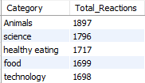
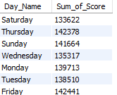
Reactions by Content Category top 5:
SELECT c.Category, COUNT(r.Content_Id) AS Total_Reactions FROM reaction rJ OIN content c ON r.Content_Id = c.Content_Id GROUP BY c.Category ORDER BY Total_Reactions DESC limit 5;
score by day::
SELECT DAYNAME(r.Date) AS Day_Name, SUM(rt.Score) AS Sum_of_ScoreFROM reaction rJOIN reactiontypes rt ON r.reaction_type = rt.reaction_typeGROUP BY DAYNAME(r.Date);

Slide 11
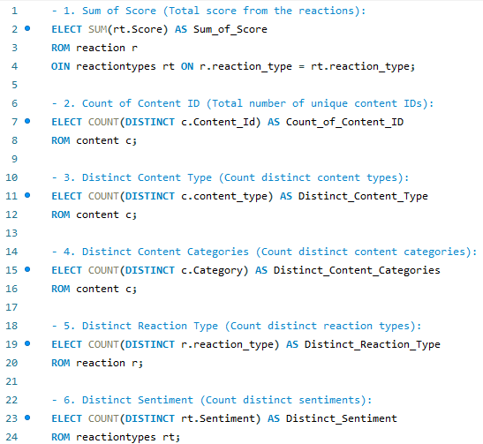
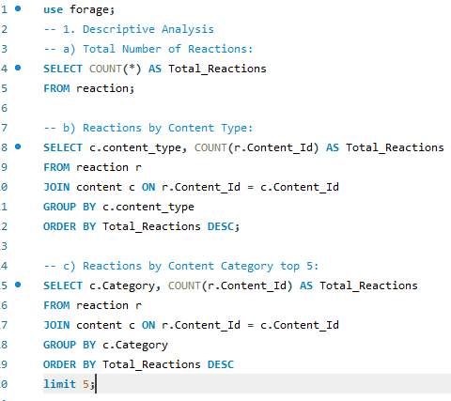

Slide 12
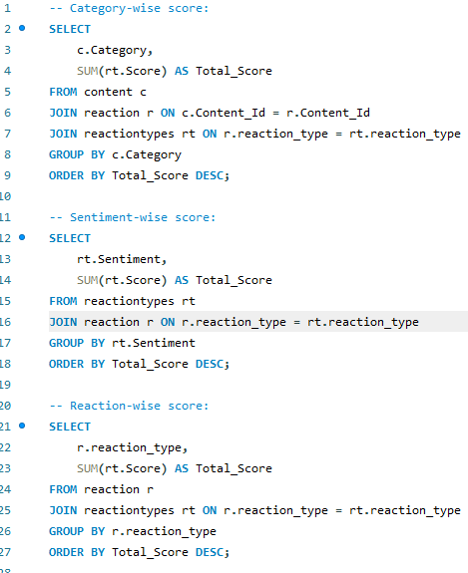
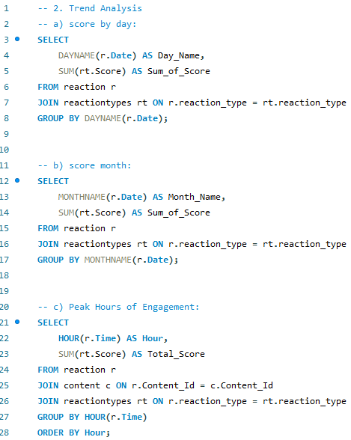

Slide 13







MEET OUR TEAM
ANDREW FLEMING ​
MARCUS ROMPTON
Flora Berggren​
Rajesh Santoshi​
CHIEF TECHNOLOGY ARCHITECT
SENIOR PRINCIPAL
DATA ANALYST
DATA SCIENTIST

Slide 14
SUMMARY
This project provided valuable insights into social media engagement using SQL and data analysis techniques. Key findings include that certain content categories and positive sentiments drive higher user interaction, while peak engagement occurs at specific times of the day. By leveraging SQL for detailed analysis and Power Query for data cleaning, this project offers actionable insights that can help optimize content strategies and enhance user engagement on social media platforms.

Slide 15
THANK YOU
Rohit Waghmare
wrohit551@email.com

